Slide 1

CE-QUAL-W2 Overview
UNCLASSIFIED
Todd Steissberg, PhD, PE
Environmental Laboratory
U.S. Army Engineer Research and Development Center
August 2, 2023
UNCLASSIFIED

Slide 2

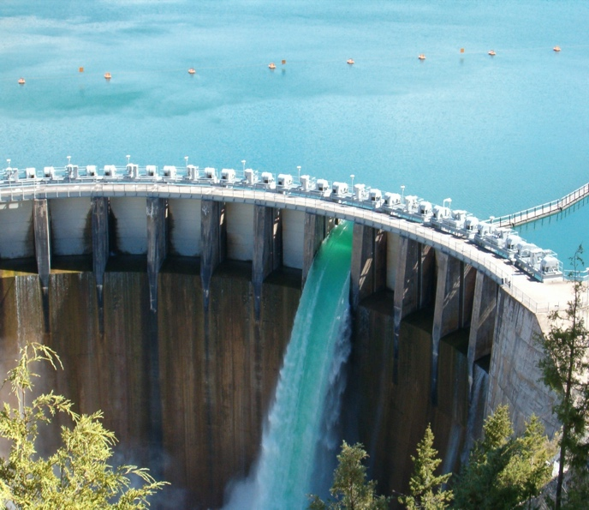
CE-QUAL-W2 Overview
CE‐QUAL‐W2 is a two‐dimensional (2D), longitudinal/vertical, hydrodynamics and water quality model. It enables characterization of the vertical and longitudinal changes in a reservoir. The model assumes the reservoir is “well mixed” laterally, with no variation from one side of the channel to the other in a given layer (vertical) and segment (longitudinal).
Released in 1986
Significant upgrades funded by EMRRP, ANSRP, and HH&C SET Numerical Model Maintenance Program
CE-QUAL-W2 has been applied to rivers, lakes, reservoirs, estuaries, and combinations thereof.
CE-QUAL-W2 incorporates the following water quality capabilities:
Longitudinal-vertical hydrodynamics and water quality in stratified and non-stratified systems
Nutrients, dissolved oxygen, and organic matter cycles
Selective withdrawal from stratified reservoir outlets
Multiple algae, epiphyton/periphyton, zooplankton, and macrophytes
Fish habitat
Sediment diagenesis
Generic water quality groups
Hydraulic structures (weirs, spillways, pipes, culverts)
Dynamic shading algorithm based on topographic and vegetative cover.

Slide 3
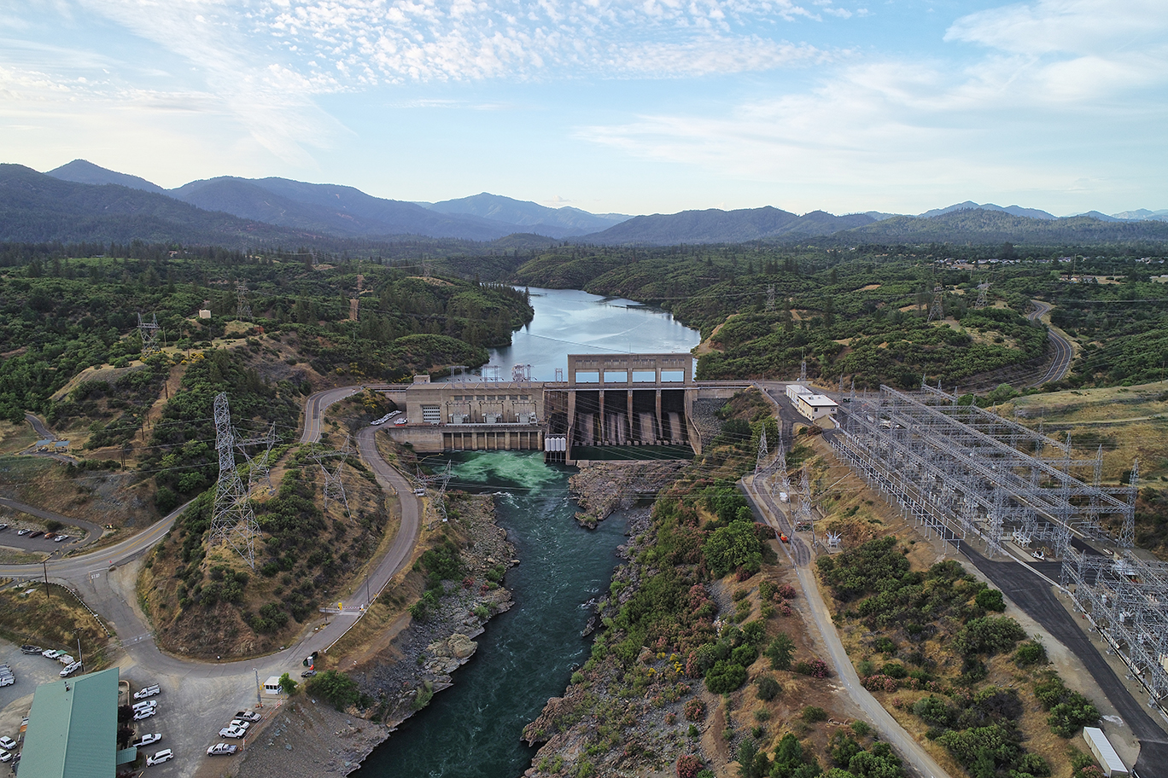

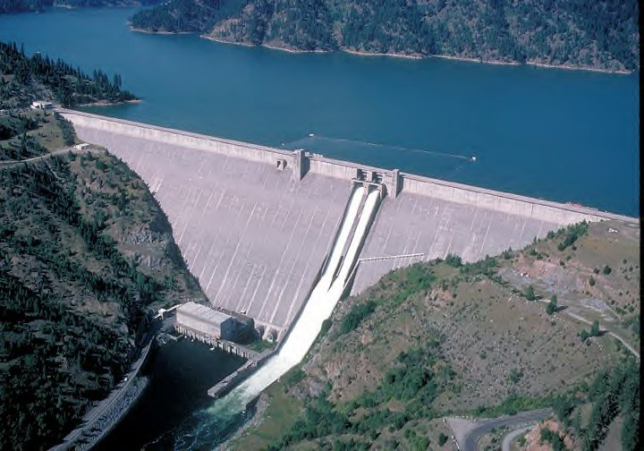
Purpose
CE-QUAL-W2 simulates the water quality in reservoirs and reservoir-river systems.
It captures the important vertical and longitudinal dynamics and water quality transformations and flows in these systems.
The model supports the high priority needs of USACE and other organizations for environmental assessment, restoration, and management.
CE-QUAL-W2 provides flow and water quality information to help improve management of critical downstream habitat.
Keswick Dam, Sacramento River
Detroit Dam, Oregon
Dworshak Dam, Idaho
Notes:
CE-QUAL-W2 is an important model in the Water Temperature Modeling Platform (WTMP) of the California Central Valley Project.
https://www.usbr.gov/mp/bdo/docs/cvp-wtmp-factsheet-20210617.pdf

Slide 4
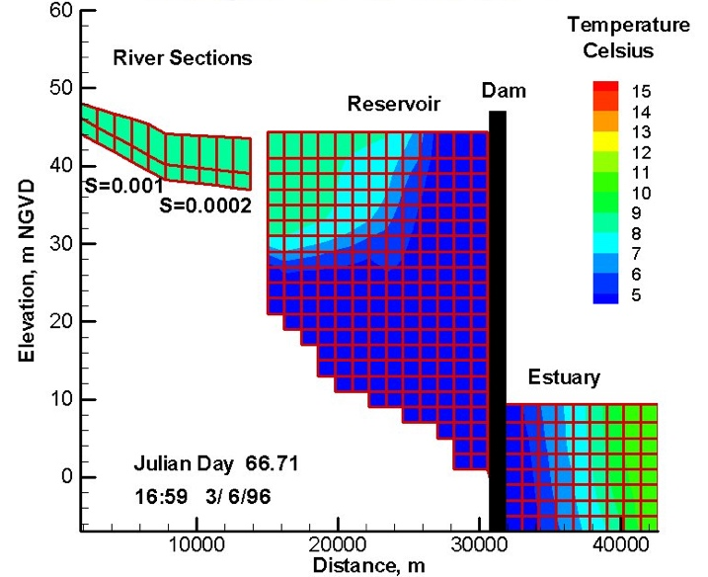
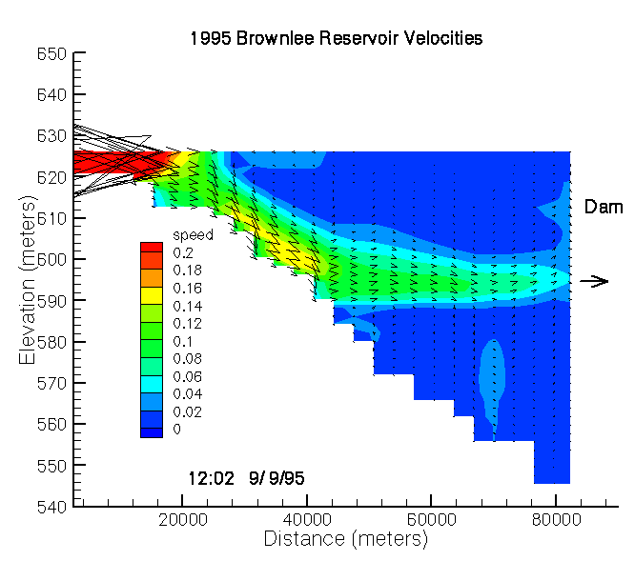
Ideal CE-QUAL-W2 Applications
Most reservoirs experience significant vertical thermal stratification during spring and summer. The stratification significantly affects water quality. Low dissolved oxygen concentrations often exist in the bottom portion of the water column (hypolimnion). This leads to the formation of compounds, such as hydrogen sulfide, that are harmful to aquatic life and people. The stratification also affects the hydrodynamics, including the vertical mixing of reservoirs, important for restoring dissolved oxygen to the hypolimnion. CE-QUAL-W2 simulates these important hydrodynamic and water quality processes.
Many reservoirs can experience significant longitudinal water quality variability (gradients) due to pollution inflows and other factors. CE-QUAL-W2 simulates the longitudinal as well as the vertical dynamics and water quality changes through the reservoir system.
CE-QUAL-W2 assumes lateral homogeneity. Therefore, it is best suited for relatively long and narrow waterbodies that exhibit longitudinal and vertical water quality gradients.

Slide 5
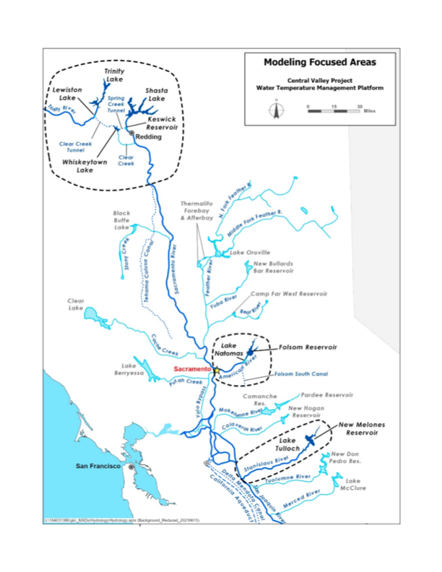
Past and Current Applications of CE-QUAL-W2
CE-QUAL-W2 is widely used by USACE and other federal, state, and local agencies for environmental impact assessments, planning studies, etc. Agencies that use CE-QUAL-W2 as their standard reservoir water quality model include:
U.S. Geological Survey (USGS)
U.S. Bureau of Reclamation
U.S. Environmental Protection Agency (EPA)
State of California
More than 1,100 model applications have been developed worldwide for reservoirs, rivers, estuaries, and other water bodies since CE-QUAL-W2 was released in 1986.
CE-QUAL-W2 is also used as a research tool by researchers at universities and other organizations.
At least 1,500 publications utilized or cited CE-QUAL-W2 in the year 2022 alone.
Recent Studies:
Water Temperature Modeling Platform, California Central Valley Project (USBR and State of California): This platform applies CE-QUAL-W2 for ongoing and future operations decision-making
USACE Northwest Division, Columbia and Snake River Watershed
Columbia System Reservoir Operation (CRSO) Project
Columbia River Treaty (CRT) Project
Philadelphia District, Lehigh River Water Quality Modeling
Region of Application:
Water Temperature Modeling Platform
California Central Valley Project

Slide 6
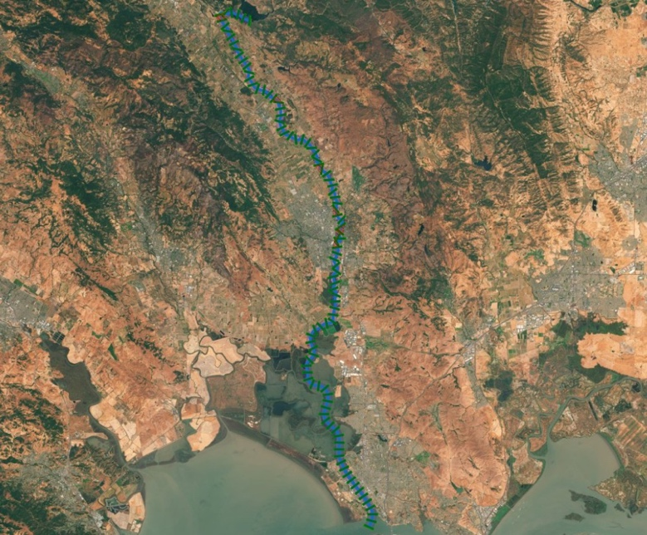
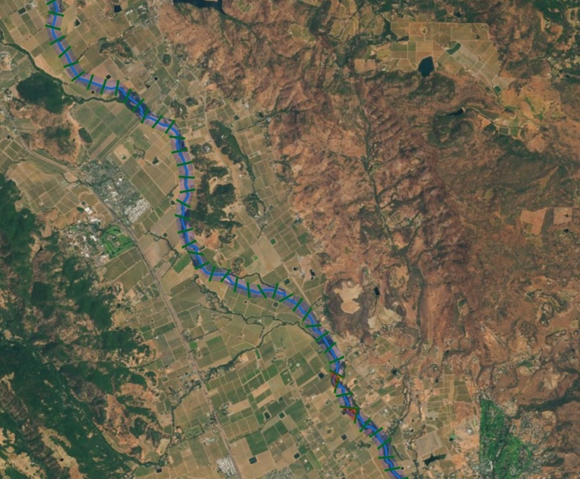
Benefits
CE-QUAL-W2 has been in use since 1986 as a tool for water quality managers to assess the impacts of management strategies on reservoir, lake, and estuarine systems.
A predominant feature of the model is its ability to compute the two-dimensional velocity field for narrow systems that stratify. In contrast with many reservoir models that are zero-dimensional with regards to hydrodynamics, the ability to accurately simulate transport can be as important as the water column kinetics in accurately simulating water quality.
Applications include:
Planning Studies
Environmental Impact Assessments
Ecosystem Restoration Projects
Real-Time Systems Operation and Decision-Making

Slide 7
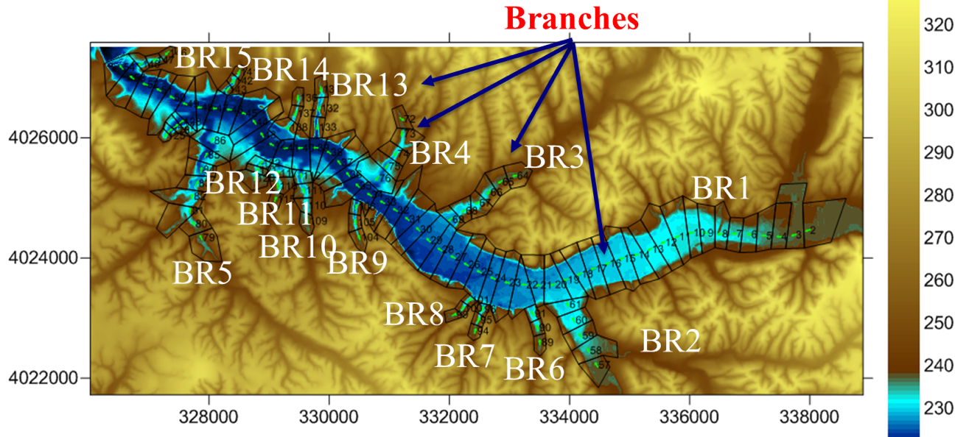
Download/Access
CE-QUAL-W2 is an open-source and public domain model.
It may be downloaded free of charge from the CE-QUAL-W2 public GitHub site, https://github.com/EcohydrologyTeam/CE-QUAL-W2
Executable programs: https://github.com/EcohydrologyTeam/CE-QUAL-W2/tree/main/executables
Example models: https://github.com/EcohydrologyTeam/CE-QUAL-W2/tree/main/examples
Source code: https://github.com/EcohydrologyTeam/CE-QUAL-W2/tree/main/src

Slide 8
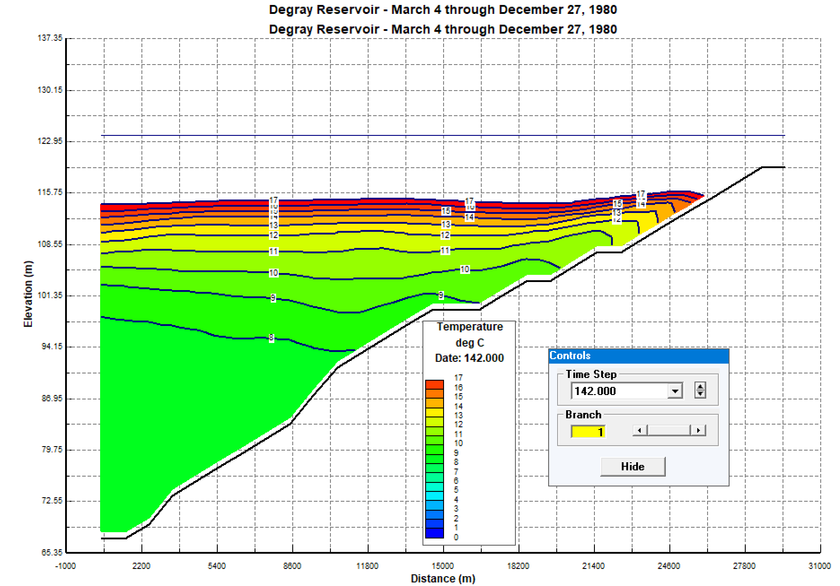
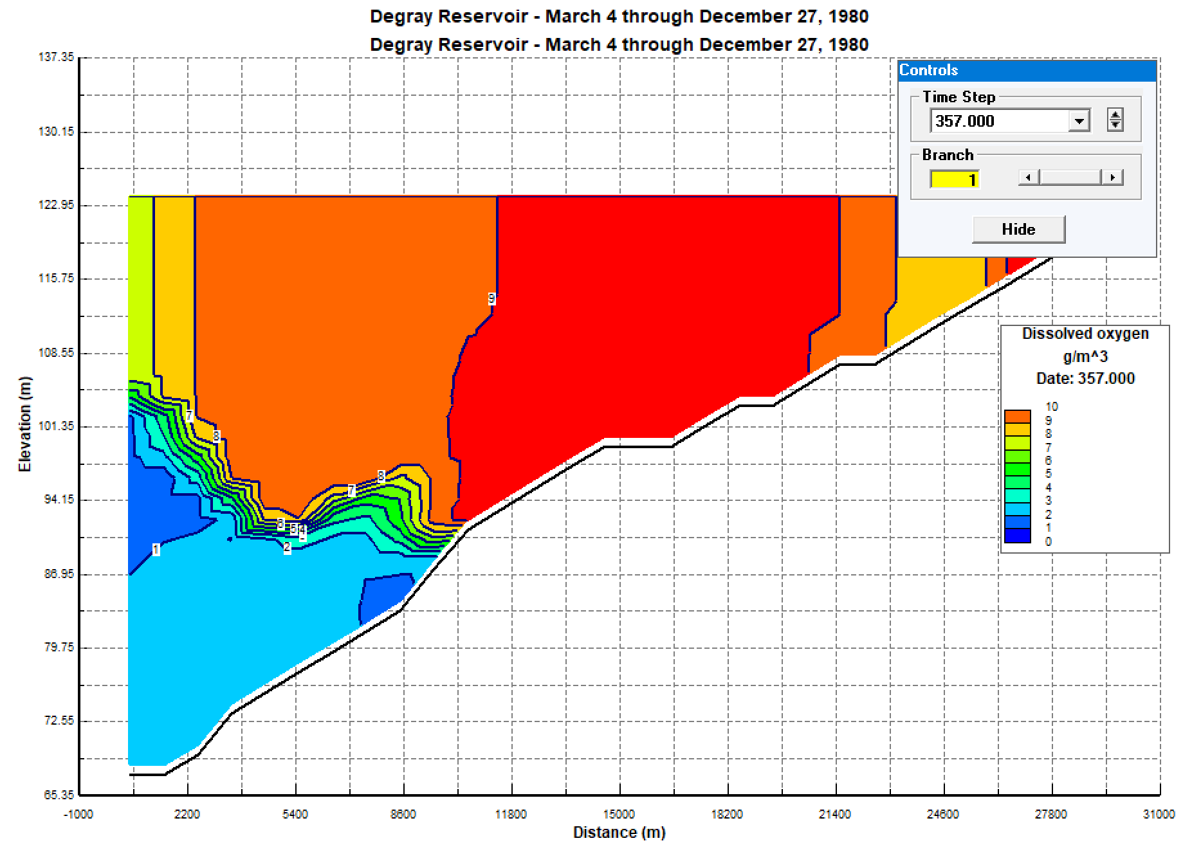
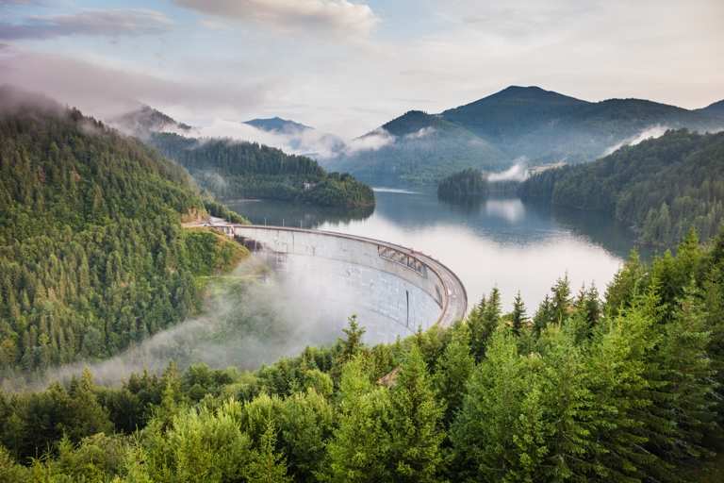
Documentation and Training Materials
User’s manual:
https://github.com/EcohydrologyTeam/CE-QUAL-W2/tree/main/documentation/model
Auto-port selection methodology:
https://github.com/EcohydrologyTeam/CE-QUAL-W2/tree/main/documentation/USGS
User’ guide for post-processing tools:
https://github.com/EcohydrologyTeam/CE-QUAL-W2/tree/main/documentation/W2tools%20post-processor
User’s guide for the Control File Converter utility program:
https://github.com/EcohydrologyTeam/CE-QUAL-W2/tree/main/documentation/control%20file%20converter
The lecture slides, examples, program executables and other materials presented during the July 2023 CE-QUAL-W2 training course are available at:
https://github.com/EcohydrologyTeam/CE-QUAL-W2-Workshop-2023

Slide 9
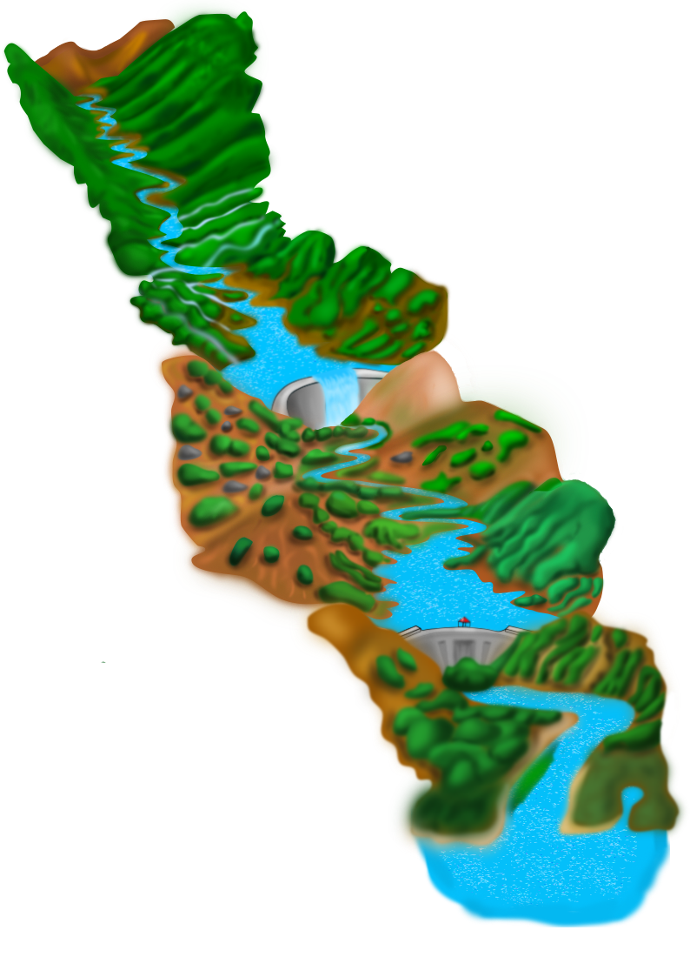
Acknowledgements
Coordination and Training:
Lauren Melendez, ERDC Environmental Laboratory
Development:
Scott Wells, Portland State University
Zhonglong, Zhang, Portland State University
Isaac Mudge, USACE New Orleans District
Funding and Support:
USACE Numerical Model Maintenance Program, Hydraulics, Hydrology, and Coastal Community of Practice (HH&C CoP)
Ecosystem Management and Restoration Research Program (EMRRP)
Aquatic Nuisance Species Research Program (ANSRP)
Graphics by Lauren Melendez

